Slide 1



DISSERTATION - 1
Question Answer Based Interactive Storytelling Using Generative AI
Generating meaningful narratives through structured Q&A inputs
Number: 124MTCM1008
M-Tech Final year project
Semister : III
Anjali Madan Jha
Guided by: Dr.Vidyullata Devmane
Computer Engineering

Slide 2











Project Overview
Introduction
Introduction
01
01
Research Objectives
05
Literature Review
02
⁠Proposed Solution
06
⁠Research Gaps
03
Methodology
07
Problem Statement
04
Thank You
08

Slide 3



Question–answer–based story generation is an emerging field in Generative AI that focuses on transforming user-driven inputs into coherent, contextually rich narratives. With advancements in Large Language Models (LLMs), machines can now understand natural language queries, capture user intent, and generate personalized stories that feel meaningful and human-like. This project explores how LLMs can be leveraged to build an automated system that converts structured or unstructured questions and answers into creative, dynamic stories.
The growing demand for interactive storytelling in education, entertainment, gaming, and digital content has highlighted the need for intelligent systems that adapt to user inputs. By integrating LLMs with a guided question–answer framework, this project aims to enhance user engagement and ensure story coherence, creativity, and relevance. The objective is to design a robust, scalable model capable of generating high-quality narratives based on user-provided responses.
introduction
introduction

Slide 4
Literature Review
Sr | Year | Authors | Title | Venue | Idea Summary | Method / Tech Used | Research Gap (for your Q&A story project) | Link
1 | 2024 | R. Farrell et al. | LLMs as Narrative Planning Search Guides | IEEE Transactions on Games | Uses LLMs to guide the creation of coherent textual narrative sequences. | GPT-based heuristic search | No Q&A interaction, no personalized story shaping. | PDF: https://cs.uky.edu/~sgware/reading/papers/farrell2024large.pdf
2 | 2023 | Y. Huang et al. | Guided Story Generation with External Knowledge | IEEE Access | Generates text stories using structured knowledge graphs + LLM. | GPT-2/3 + knowledge integration | Doesn’t take Q&A input; limited personalization. | https://ieeexplore.ieee.org/document/10090973
3 | 2023 | G. Tambwekar et al. | Controllable Neural Story Generation | IEEE Transactions on Games | Controls style, theme, and emotion in generated stories. | Reinforced LSTM + LLM | Not interactive; lacks user-driven Q&A shaping. | https://ieeexplore.ieee.org/document/10021351
4 | 2023 | K. Li et al. | Plot-Guided Story Generation via Prompting | IEEE Access | Uses prompts and templates to steer LLM story outputs. | Prompt engineering for GPT-3 | No dynamic question-answering component. | https://ieeexplore.ieee.org/document/10289342
5 | 2022 | S. Ammanabrolu et al. | Hierarchical Neural Story Generation | IEEE Transactions on Games | Generates multi-paragraph stories with plot control. | Hierarchical Transformer | No interactive Q&A branching. | https://ieeexplore.ieee.org/document/9783130

Slide 5
Literature Review
Sr | Year | Authors | Title | Venue | Idea Summary | Method / Tech Used | Research Gap (for your Q&A story project) | Link
6 | 2022 | M. Mao et al. | Character-centric Story Generation | IEEE Access | Focuses on character consistency in long stories. | Transformer decoder | No mechanism for user-driven Q&A personalization. | https://ieeexplore.ieee.org/document/9712325
7 | 2024 | R. Zhang et al. | Prompt-Driven Narrative Generation Using LLMs | IEEE Access | Improves coherence by structuring user prompts → controlled text stories. | Instruction-tuned LLM | No Q&A pipeline; only single-shot prompts. | https://ieeexplore.ieee.org/document/10527305
8 | 2023 | M. Peng et al. | Interactive Story Generation with Dialogue Inputs | IEEE Access | Text story generation using dialogue turns (closest to Q&A). | BART / GPT dialogue → story converter | Does not explicitly structure Q&A → story pipeline. | https://ieeexplore.ieee.org/document/10045611
9 | 2022 | J. Li et al. | Long-Form Story Generation with Discourse Planning | IEEE Access | Ensures story coherence using discourse-aware planning. | Discourse Planner + LLM | Still not user-personalized; no Q&A involvement. | https://ieeexplore.ieee.org/document/9724244
10 | 2024 | H. Wu et al. | Evaluation of AI-Generated Narratives | IEEE Access | Analyzes story quality generated by LLMs. | LLM-based story metrics | Not a generation model but useful for evaluation. | https://ieeexplore.ieee.org/document/10453284

Slide 6



Research Gap
Personalization
Coherence
Control
Evaluation
Current story-generation models cannot convert user Q&A inputs into highly personalized narrative elements.
LLMs struggle to maintain consistent plot, characters, and themes across multi-step Q&A interactions.
Existing systems lack mechanisms for users to control story flow, genre, or structure through guided questions.
There is no standard framework to evaluate Q&A-based interactive stories for quality, relevance, and engagement.

Slide 7
problem statement
problem statement
Despite major progress in generative AI and large language models, current story-generation systems are still mostly prompt based and do not use structured question and answer inputs to build meaningful narratives. Existing models are unable to convert step by step user responses into coherent, personalized and context rich stories. They often lose narrative consistency in plot, characters and emotional flow when multiple user inputs are involved, which results in generic or fragmented storytelling. There is also no clear framework that allows users to control the story’s theme, tone, genre or direction through an interactive question and answer process. These limitations show the need for an intelligent system that can capture user responses in real time and generate high quality personalized stories with strong coherence, better control and improved narrative alignment.

Slide 8
Research Objectives
Structured Input Design
Personalized Story Generation
Narrative Coherence Control
Story Quality Evaluation

Slide 9





Proposed System
Context Extraction Engine
Output Delivery & Integration
User Input Acquisition
LLM-Based Story Generator

Slide 10
Methodology
Processing pipeline: from the user's answers to a finished multimodal chapter
01
02
03
04
05
06
07
Q&A Elicitation
Context Extraction
Knowledge & Memory
Prompt Engineering
LLM Generation
Flow & Consistency
Output & Media
17 questions in 4 phases; budgets of 4, 8, 12 or 17
Answers mapped to a typed StoryContext
SQLite + LRU cache; last 4 segments as context
6 phase-aware templates + user preferences
Ollama, Groq, Hugging Face or OpenAI
Freytag state machine; character and plot trackers
Formatted text, scene image, narration, music
Five-phase story progression (driven by word count)
Introduction
0–400 words
Rising Action
400–1,200
Climax
1,200–1,800
Falling Action
1,800–2,400
Resolution
2,400+ words
Custom answers and user-added questions reach the LLM prompt through a dedicated custom_elements channel, so the question set can grow without any change to code or database schema.

Slide 11
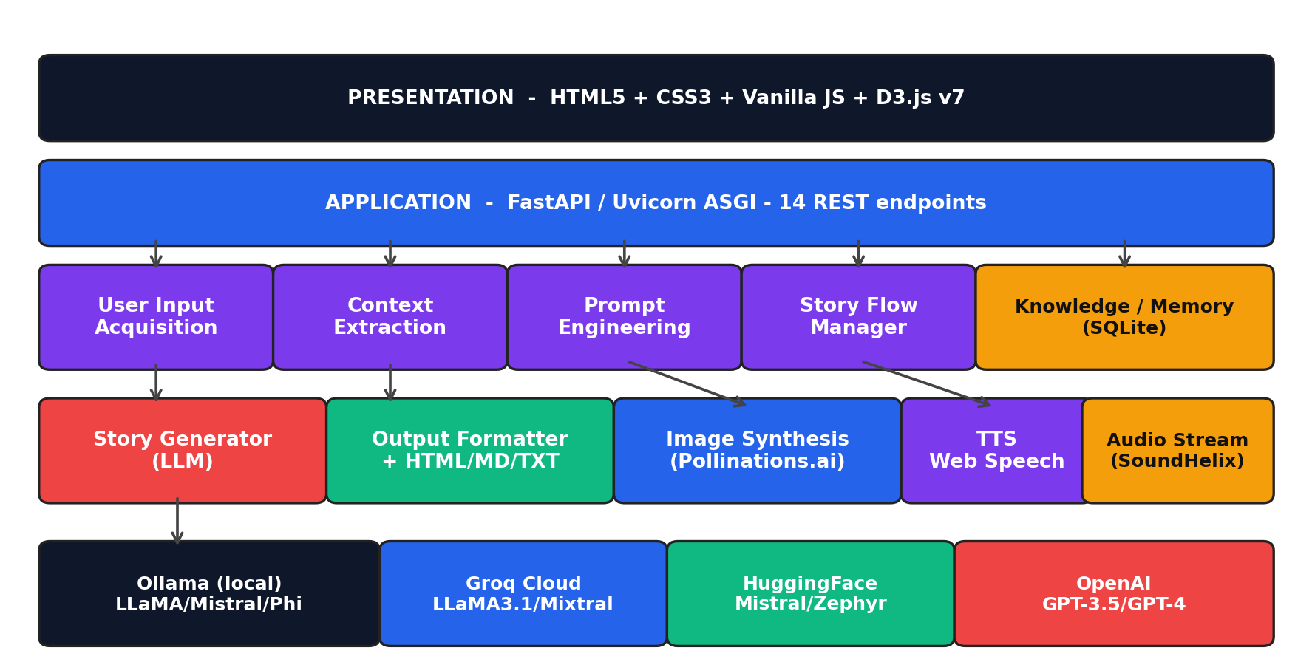
System Architecture & Tech Stack
API
Backend
Python, FastAPI, Pydantic v2, SQLite
LLM
Language models
Ollama, Groq, Hugging Face, OpenAI
IMG
Scene images
Pollinations.ai with a serial request queue
TTS
Narration & music
Web Speech API, SoundHelix tracks
D3
Reader analytics
Story Map and Character Graph
Layered design: web interface, FastAPI application layer, seven-module core and a pluggable LLM provider layer.
Frontend
UI
HTML5, CSS3, JavaScript single page
7 modules · 13 REST endpoints · ≈ 8,400 lines of code

Slide 12
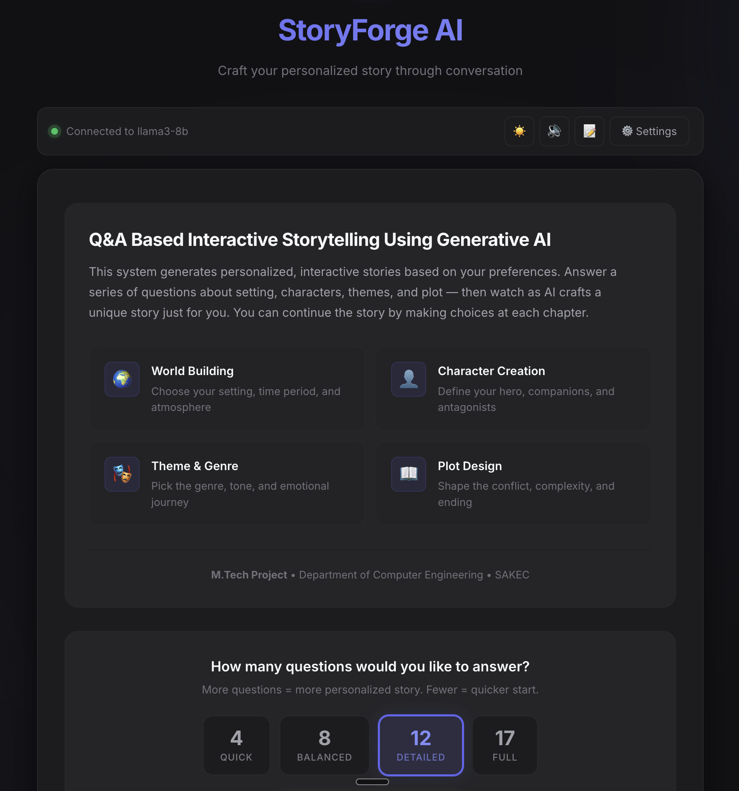
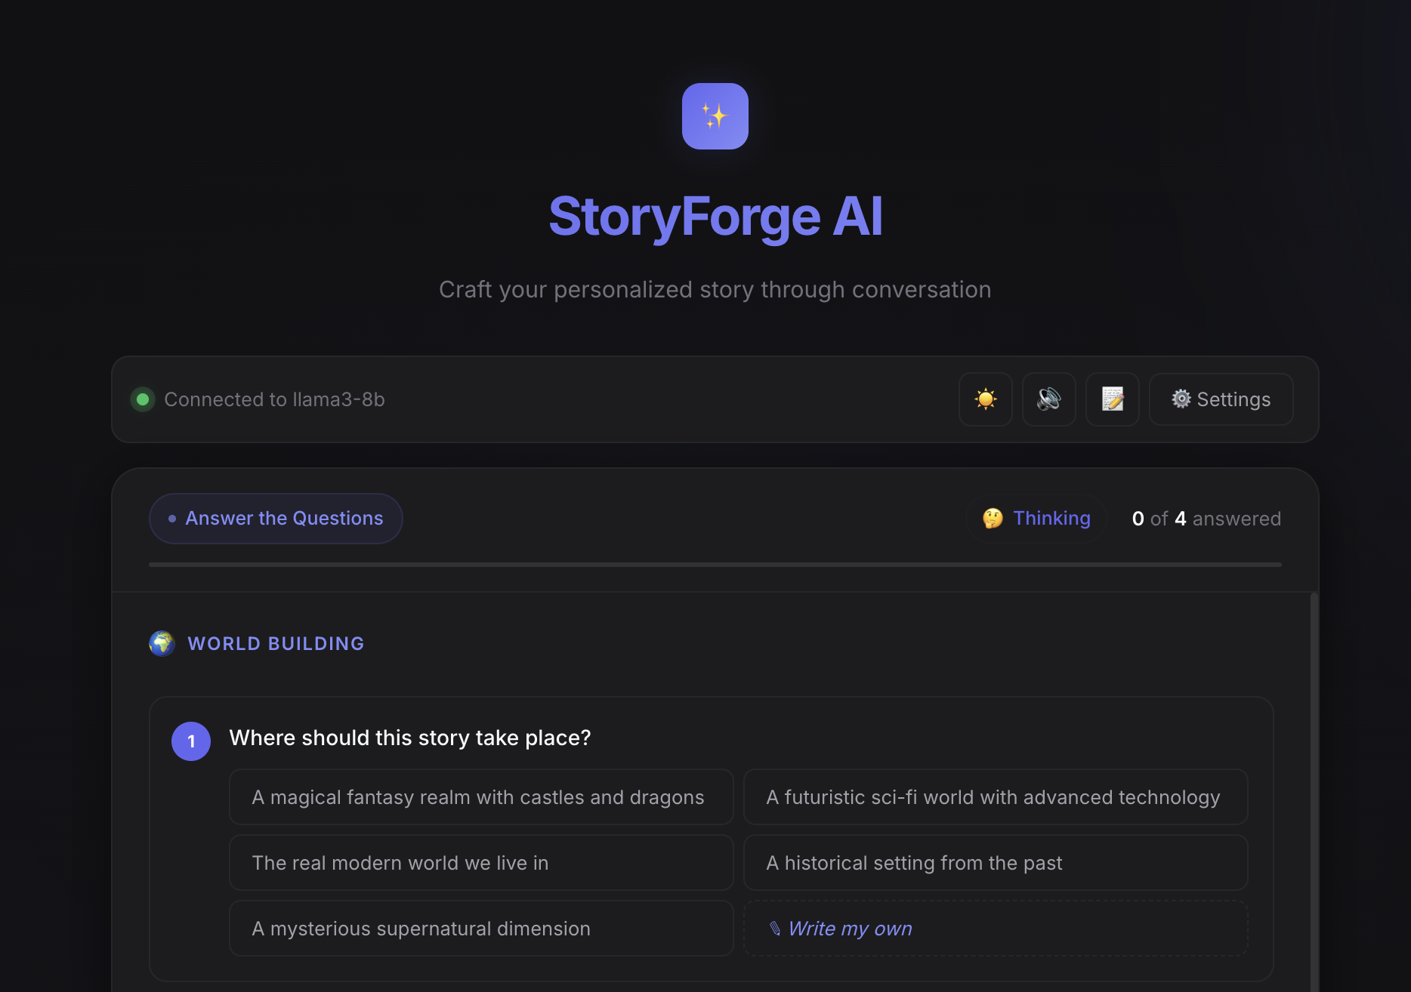
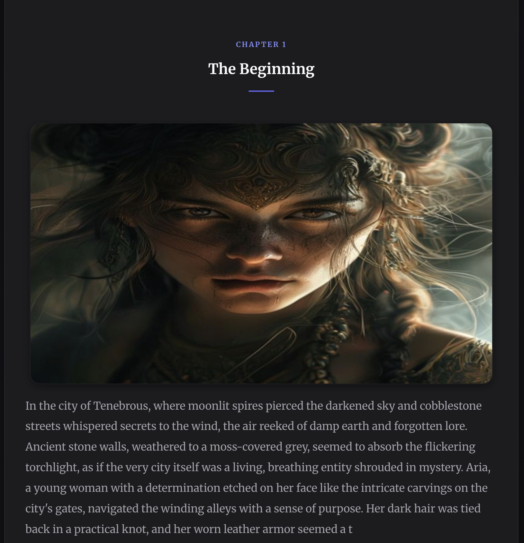
Implementation: Application Screens
Landing page
Question form
Story view
Choose a budget of 4, 8, 12 or 17 questions
Options, “Write my own” answers and user-added questions
Generated chapter with its scene illustration
Also implemented: narration controls, ambient-music toggle, Story Map, Character Graph, TXT / Markdown / HTML export and a settings panel for switching the LLM provider live.

Slide 13
Results
4.3 / 5
1.8 s
70% → <2%
0.71 → 0.80
Overall user satisfaction
First story segment (Groq LLaMA-3.1-8B)
Image failures with the serial queue
Character-detection F1 after filtering
50 generated stories and a user study with 15 participants. A 12-question budget gave the best balance: personalisation 4.3 / 5 in about 2.5 minutes.

Slide 14




Motivation
Addresses Unexplored Research Gap: Literature review of 30+ papers reveals no existing work on Q&A-driven narrative generation, presenting a novel research opportunity.
Enables User-Driven Story Creation: Structured questioning framework allows users to actively shape narratives through conversational interaction rather than passive prompting.
Technical Innovation: Integrates adaptive question generation, context-aware dialogue management, and LLM-based narrative synthesis into unified framework.
Broad Application Potential: Proposed system has applications across education, interactive entertainment, therapeutic storytelling, and content creation domains.

Slide 15
Conclusion
This project presents an interactive question-and-answer-based story generation system that uses the capabilities of large language models to create coherent, personalized, and context-rich narratives. By capturing structured user inputs and converting them into meaningful story attributes, the system demonstrates how generative AI can enhance creativity, engagement, and customization in textual storytelling. The proposed framework improves narrative coherence, strengthens personalization, and enables controlled story generation, addressing key limitations found in traditional prompt-based systems. Overall, the work highlights the potential of LLMs to transform user-driven inputs into high-quality stories with improved consistency and relevance.
Conclusion

Slide 16
Future Scope
01
Semantic understanding
02
Local image generation
03
Neural voices
DistilBERT or zero-shot LLM context extraction and NLI-based consistency checks
SDXL or FLUX.1 for offline use and the same look for each character
XTTS narration with a distinct voice for every character
04
Mood-aware music
05
Collaborative stories
06
Multilingual & scalable
Music that follows each segment's mood, not only the genre
Multi-user sessions with shared questions and turn-taking
Hindi and Marathi stories; Docker and Redis for deployment

Slide 17

Thank You
Anjali Madan Jha

Slide 18


